Slide 1
Database Systems
Query Processing

Slide 2
Last Lecture…
Indexes
Any questions?

Slide 3
This Lecture…
Query Processing: Overview
What?
Why?
How? (Basics)

Slide 4
Query Processing
What happens to a query inside the DBMS?
Query processing considers this issue.

Slide 5
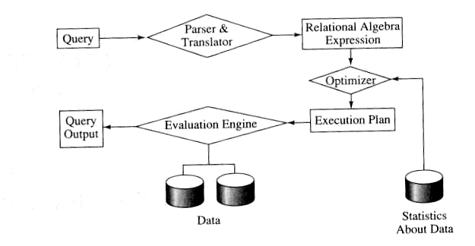
Steps in QP…
The steps involved in query processing include…
  Parsing and translation
  Optimization
  Evaluation

Slide 6
Steps in QP… (contd.)
Parsing & translation step verifies the correctness of the query and converts the query into an internal form (usually an extended relational algebra expression)
This internal form is either a tree (i.e. query tree) or a graph (i.e. query graph)

Slide 7
Steps in QP… (contd.)
Next, an efficient execution strategy for retrieving the results of the query from the database files is generated. This step is called query optimization.
This is the heart of query processing in a relational database system
The evaluation engine executes the query according to the chosen plan

Slide 8
Parsing & Translating…
The first step in query processing is to convert the query into an form that can be executed
Consider the following schema
S(sno, sname, status, city)
P(pno, pname, colour, weight)
SP(sno, pno, qty)

Slide 9
Parsing & Translating… (contd.)
SELECT s.sname
FROM S, SP
WHERE S.sno = SP.sno AND
SP.pno = ‘P2’
We can express this query as a relational algebra as follows…

Slide 10
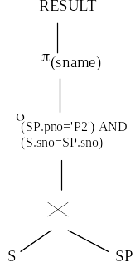
Parsing & Translating… (contd.)

Slide 11
Parsing & Translating… (contd.)
Usually, a SELECT-FROM-WHERE-GROUP BY called a query block is converted an extended relational algebra expression
There can be many query blocks (i.e. with nested queries) in a complex query

Slide 12
Why do we need Query Optimization?
Consider the following number of tuples for S and SP
  S – 100 pages
  SP - 10000 pages
Cost for computing Cartesian Product:
  - read 10,000 * 100 pages
  - write 1,000,000 pages (intermediate result)
Selection
  - read 1,000,000 pages
  - keep 50 tuples (assuming 50 tuple SP.pno = ‘P2’)
Total number of disk I/O ~ 3,000,000 disk I/Os

Slide 13
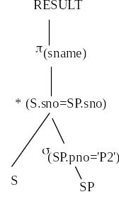
Optimization? (contd.)
Consider the following relational algebra, which produces the same result
Selection operator
  Read 10,000 pages
  Keep the result, 50 tuples in memory
Join with S
  Read 100 pages
Total cost 10,100 disk I/Os

Slide 14
Heuristic Optimization
A query can have many equivalent query trees
Optimizer must find an efficient query plan to execute
Heuristic rules are used for algebraic optimization

Slide 15
Equivalence Rules…
To transform a relational algebra expression from to an equivalent efficient query expression, certain equivalence rules are used.

Slide 16
Equivalence Rules… (contd.)
Conjunctive selection operations can be deconstructed into a sequence of individual selections. This transformation is referred to as a cascade of σ.
σ_{C1 ∧ C2}(E) = σ_{C1} (σ_{C2} (E))
Selection operations are commutative.
σ_{C1} (σ_{C2} (E)) = σ_{C2} (σ_{C1} (E))
Cascade of Π.
Π_{L1} ( Π_{L2} (… (Π_{Ln} (E)…)) = Π_{L1} ( E )

Slide 17


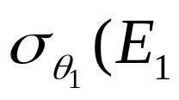
Equivalence Rules… (contd.)
Selections can be combined with Cartesian products and theta joins.
a. _{θ} E2
This expression is just the definition of the theta join.
b. _{θ 2} E2) = E1 _{θ1∧θ2} E2
Etc.

Slide 18
Equivalence Rules (contd.)
Equivalence rules states that two expressions are equal
It does not state, which one is better
A large number of plans are possible! Estimating the cost for each is prohibitively expensive
The optimizer uses heuristic rules to prune the plan space (reduce the number of plans to be considered)
  E.g. Bring selects down, avoid cartesian products, etc.

Slide 19
Indexes and cost of query plans…
Using an index does not necessarily mean efficient query plan.
Can you think of an instance where using an index is inefficient?
Query optimizer estimates costs to compare different execution plans

Slide 20
Cost estimation
Execution plan has
  A set of relational algebra operators (query plan) to obtain the result of the query
  Algorithm used to evaluate each relational algebra operators
Some relational algebra operators have many possible ways (algorithms).
Costs may differ significantly based on the chosen algorithm
We will study algorithms some algorithms used for simple selections and joins

Slide 21
Schema for Examples
Sailors (sid: integer, sname: string, rating: integer, age: real)
Reserves (sid: integer, bid: integer, day: dates, rname: string)
Reserves:
  Each tuple is 40 bytes long, 100 tuples per page, 1000 pages.
Sailors:
  Each tuple is 50 bytes long, 80 tuples per page, 500 pages.
Notes:
4

Slide 22
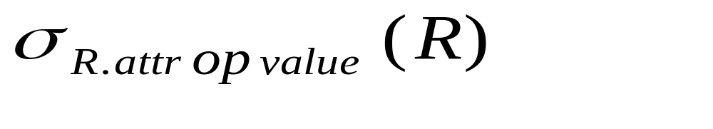
Simple Selections
SELECT *
FROM Reserves R
WHERE R.rname < ‘C%’
Of the form
Size of result approximated as size of R * reduction factor; we will consider how to estimate reduction factors later.
With no index, unsorted: Must essentially scan the whole relation; cost is M (#pages in R).
With an index on selection attribute: Use index to find qualifying data entries, then retrieve corresponding data records. (Hash index useful only for equality selections.)
Notes:
11

Slide 23
Using an Index for Selections
Cost depends on #qualifying tuples, and clustering.
  Cost of finding qualifying data entries (typically small) plus cost of retrieving records (could be large w/o clustering).
  In example, assuming uniform distribution of names, about 10% of tuples qualify (100 pages, 10000 tuples). With a clustered index, cost is little more than 100 I/Os; if unclustered, upto 10000 I/Os!
Notes:
12

Slide 24


Equality Joins With One Join Column
SELECT *
FROM Reserves R1, Sailors S1
WHERE R1.sid=S1.sid
In algebra: R S. Common! Must be carefully optimized. R S is large; so, R S followed by a selection is inefficient.
Assume: M tuples in R, p_{R} tuples per page, N tuples in S, p_{S} tuples per page.
  In our examples, R is Reserves and S is Sailors.
Cost metric: # of I/Os. We will ignore output costs.
Notes:
5

Slide 25
Simple Nested Loops Join
foreach tuple r in R do
foreach tuple s in S do
if r_{i} == s_{j} then add <r, s> to result
For each tuple in the outer relation R, we scan the entire inner relation S.
  Cost: M + p_{R} * M * N = 1000 + 100*1000*500 I/Os.
Notes:
6

Slide 26
Page-oriented Nested Loop Join
Page-oriented Nested Loops join: For each page of R, get each page of S, and write out matching pairs of tuples <r, s>, where r is in R-page and S is in S-page.
  Cost: M + M*N = 1000 + 1000*500
  If smaller relation (S) is outer, cost = 500 + 500*1000

Slide 27
Block Nested Loops Join
Use one page as an input buffer for scanning the inner S, one page as the output buffer, and use all remaining pages to hold ``block’’ of outer R.
  For each matching tuple r in R-block, s in S-page, add <r, s> to result. Then read next R-block, scan S, etc.
R & S
Join Result
Hash table for block of R
(k < B-1 pages)
. . .
. . .
. . .
Input buffer for S
Output buffer
Notes:
9

Slide 28
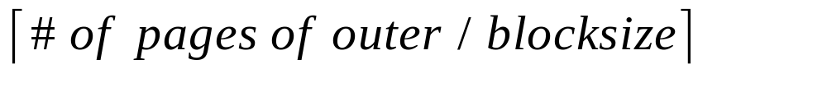
Examples of Block Nested Loops
Cost: Scan of outer + #outer blocks * scan of inner
  #outer blocks =
  Block size = available buffers - 2
With Reserves (R) as outer, and 100 pages of R:
  Cost of scanning R is 1000 I/Os; a total of 10 blocks.
  Per block of R, we scan Sailors (S); 10*500 I/Os.
  If space for just 90 pages of R, we would scan S 12 times.
With 100-page block of Sailors as outer:
  Cost of scanning S is 500 I/Os; a total of 5 blocks.
  Per block of S, we scan Reserves; 5*1000 I/Os.

Slide 29
Index Nested Loops Join
foreach tuple r in R do
foreach tuple s in S where r_{i} == s_{j} do
add <r, s> to result
If there is an index on the join column of one relation (say S), can make it the inner and exploit the index.
  Cost: M + ( (M*p_{R}) * cost of finding matching S tuples)
For each R tuple, cost of probing S index is about 1.2 for hash index, 2-4 for B+ tree. Cost of then finding S tuples (assuming Alt. (2) or (3) for data entries) depends on clustering.
  Clustered index: 1 I/O (typical), unclustered: upto 1 I/O per matching S tuple.

Slide 30

Sort-Merge Join (R S)
i=j
Sort R and S on the join column, then scan them to do a “merge’’ (on join col.), and output result tuples.
  Advance scan of R until current R-tuple >= current S tuple, then advance scan of S until current S-tuple >= current R tuple; do this until current R tuple = current S tuple.
  At this point, all R tuples with same value in Ri (current R group) and all S tuples with same value in Sj (current S group) match; output <r, s> for all pairs of such tuples.
  Then resume scanning R and S.
Notes:
11

Slide 31
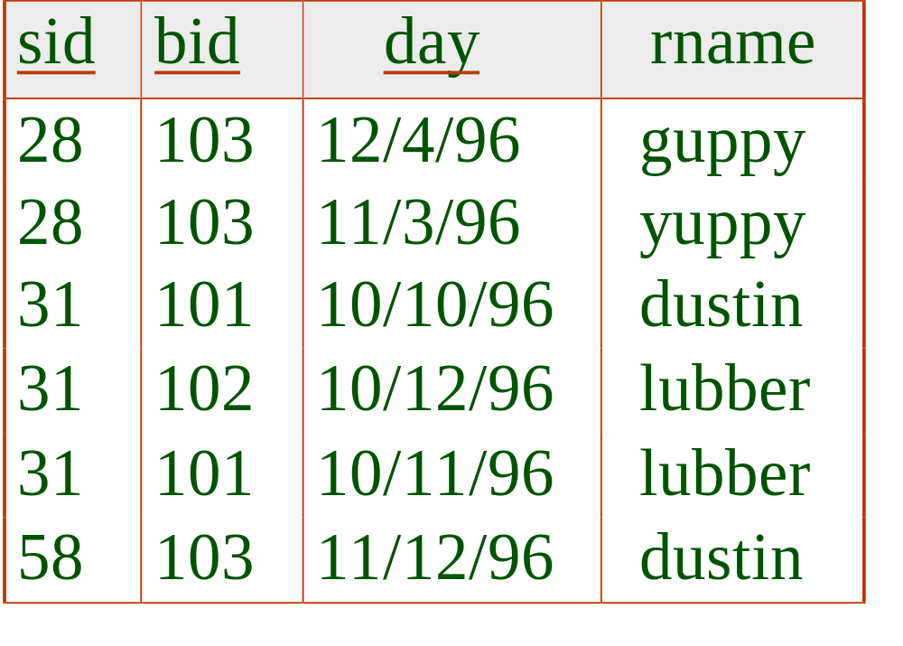
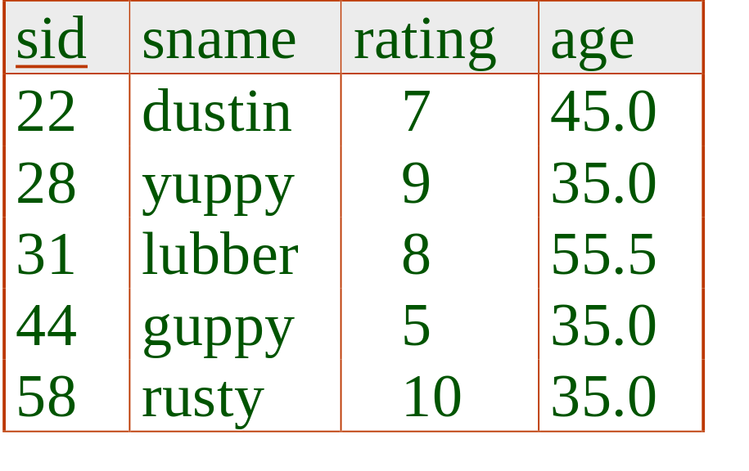
Example of Sort-Merge Join
R is scanned once; each S group is scanned once per matching R tuple. (Multiple scans of an S group are likely to find needed pages in buffer.)
Cost: O(M log M) + O(N log N) + (M+N)
  The cost of scanning, M+N, could be M*N (very unlikely!)
Notes:
12

Slide 32
Cost-based Optimization
The fact that there are many algorithms for relational operators, choosing a good query plan using heuristics is not enough
We can calculate the cost of each candidate query tree with the possible algorithms for each operator (& the difference can be significant)
To compare such query plans, cost-based optimization techniques are used

Slide 33
Cost Estimation
For each plan considered, must estimate cost:
  Must estimate cost of each operation in plan tree.
    Depends on input cardinalities.
    We’ve already discussed how to estimate the cost of operations (sequential scan, index scan, joins, etc.)
  Must estimate size of result for each operation in tree!
    Use information about the input relations.
    For selections and joins, assume independence of predicates.
Notes:
8

Slide 34
Statistics and Catalogs
Need information about the relations and indexes involved. Catalogs typically contain at least:
  # tuples (NTuples) and # pages (NPages) for each relation.
  # distinct key values (NKeys) and NPages for each index.
  Index height, low/high key values (Low/High) for each tree index.
Notes:
8

Slide 35
Statistics and Catalogs
Catalogs updated periodically.
  Updating whenever data changes is too expensive; lots of approximation anyway, so slight inconsistency ok.
More detailed information (e.g., histograms of the values in some field) are sometimes stored.

Slide 36
Size Estimation and Reduction Factors
SELECT attribute list
FROM relation list
WHERE term1 AND ... AND termk
Consider a query block:
Maximum # tuples in result is the product of the cardinalities of relations in the FROM clause.
Reduction factor (RF) associated with each term reflects the impact of the term in reducing result size. Result cardinality = Max # tuples * product of all RF’s.
  Implicit assumption that terms are independent!
  System R:
  Term col=value has RF 1/NKeys(I), given index I on col
  Term col1=col2 has RF 1/MAX(NKeys(I1), NKeys(I2))
  Term col>value has RF (High(I)-value)/(High(I)-Low(I))
Notes:
9

Slide 37
Summary
Query Processing consists of several steps
Query optimization is an important task in a relational DBMS.
Must understand optimization in order to understand the performance impact of a given database design (relations, indexes) on a workload (set of queries).
Two parts to optimizing a query:
  Consider a set of alternative plans (heuristics are used to reduce the number of possible plans to consider).
  Must estimate cost of each plan that is considered.
    Must estimate size of result and cost for each plan node.
    Key issues: Statistics, indexes, operator implementations.

